Slide 1

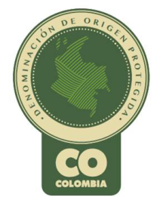


The IP and GIs of Colombian Coffee
WIPO – March, 2017
Esteban Rubio
Intellectual Property Coordinator
Colombian Coffee Growers Federation

Slide 2
Topics
Background: FNC and the IP strategy of Colombian coffee
International experience
Treaties and regulations
The Andean Community
The European Union
Switzerland
Problems: legal and technical

Slide 3
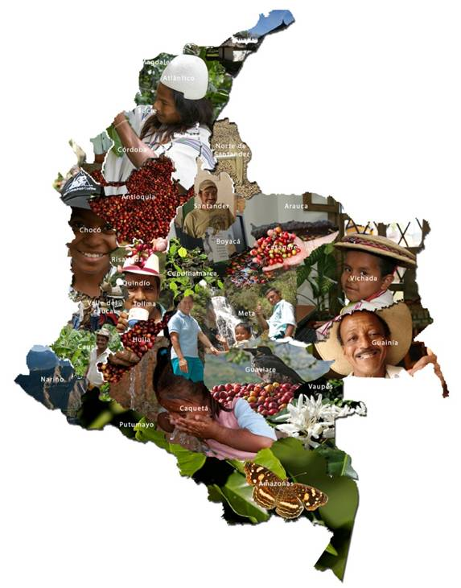
Colombia is coffee …
Background: the Colombian Coffee Growers Federation
921.000 ha.
588 municipalities
20 departaments
560.000 coffee-growers
2’000.000 employments
96% are small coffee-growers (1.5 ha.)
Notes:
La “caficultura es modelo de paz”. Alrededor de ella se ha constituido un tejido social soportado por una estructura productiva imposible de reemplazar, de la cual depende en gran medida la estabilidad democrática, la seguridad, el equilibrio social y la prosperidad del país.
Más de 741.000 empleos directos, equivalente al 31% del empleo agrícola del país
Más de 1.4 millones de empleos indirectos
La participación del PIB cafetero en el PIB agrícola es del 17%.
El valor de las exportaciones de café en 2010 representaron el 4,7% de las exportaciones nacionales.
El volumen de café exportado fue de 7,8 millones de sacos de 60kg.
El valor de la cosecha en 2011 alcanzó $4.6 billones de pesos

Slide 4
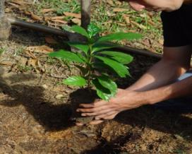
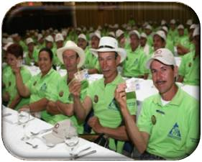

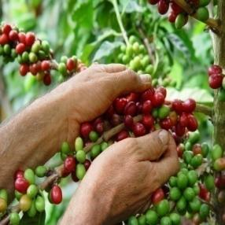
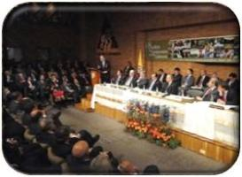
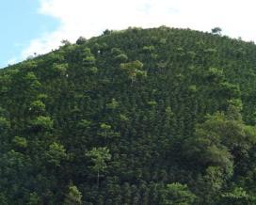


Background: the Colombian Coffee Growers Federation
The Colombian Coffee Federation supports 563.000 families
State-supported
Collective funds
Federation
Producer / coffee grower
Private NGO
Democratic
Notes:
La FNC, fundada en 1927 por los cafeteros colombianos cuyo eje central es: el Productor
La creación y funcionamiento de la FNC simboliza la creatividad de los cafeteros para enfrentar las amenazas y vicisitudes o variaciones del mercado, superar los obstáculos.
La interrelación del Gobierno y la Federación ha producido magníficos resultados, permite un diálogo y participación directa en las políticas que compete al gremio cafetero.

Slide 5
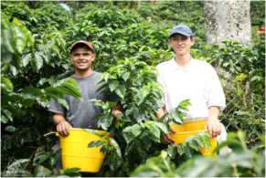
Background: the Colombian Coffee Growers Federation
Benefits (“public services”) to coffee-growing families
Cooperatives
Buencafé – (freeze dried coffee)
Cenicafé (R+D)
Purchase warranty
Innovation and investigation
Added-value strategy
Almacafé (exports – logistics)
Quality control
Promotion and publicity
Procafecol (Juan Valdez)
Education
Social investment
Manuel Mejía Foundation
Tehnical assistance
Local committees
Extension service (tech transfer)
Notes:
La Federación provee bienes a los cafeteros y logra articular a diferentes actores (gobierno, cooperación, comunidad)

Slide 6



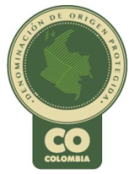
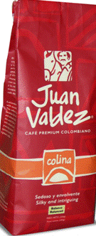

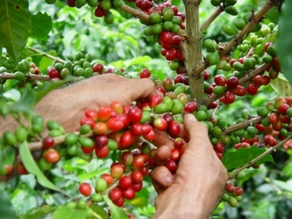

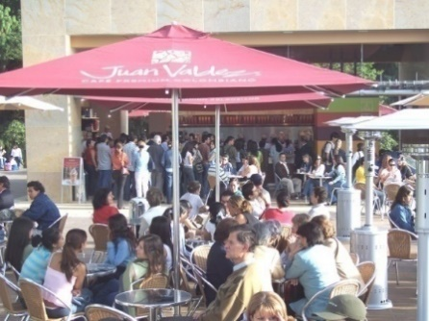
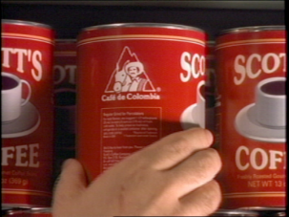
Background: the IP strategy
A strategy that strengthens the relationship with consumers
Ingredient brand
Origin
Product
Colombian
Character
Experience
Strategic partners

Slide 7
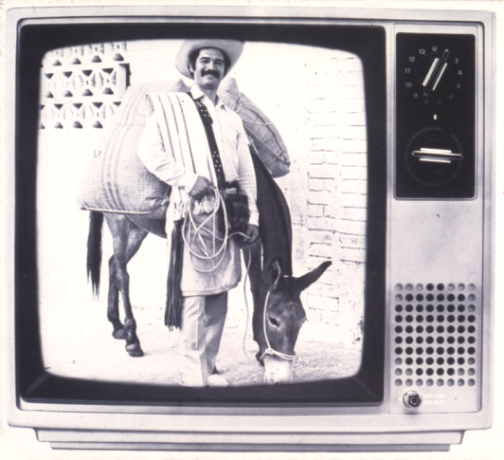
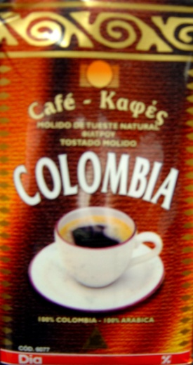
Background: the IP strategy
Strict quality controls for exports
Promotion of the unique characteristics of its origin and coffee culture
Character creation that symbolizes the positive characteristics of Colombian coffee culture
Advertisement towards consumers to generate pressure for demand over roasters
Roaster
Incentives
Ingredient-brand to 100% Colombian and a distinctive phrase

Slide 8


Current registrations
 | Protection Mechanism | Territory | Procedure
 | Trademark | International | Trademark License Agreement – TLA
 | Certification Mark | North America (USA and Canada) | Trademark License Agreement – TLA
 | Protected Geographical Indication | European Union | PGI Certification
 | Appellation of Origin | Andean Community Countries (Colombia, Ecuador, Peru and Bolivia) | DO Certification
 | Exclusive origin trademark | International | Trademark License Agreement – TLA
Colombian

Slide 9
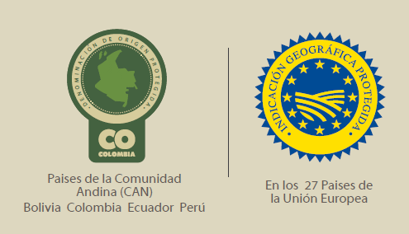
Current registrations
Legal background
Appellations of origin:
Colombian Superintendency of Industry and Trade, Resolution 4819 of March 4, 2005
Protected Geografical Indication
European Comission, 2007; Switzerland, 2013
Regional appellations of origin:
Cauca: Resolution 41788, August 10, 2011
Nariño: Resolution 6093, February 11, 2011
Huila: Resolution 17989, April 16, 2013
Santander: Resolution 50042, August 25, 2014
Sierra: Resolution 630, January 30, 2017
Tolima: Resolution 631, January 30, 2017
EU-Colombia FTA

Slide 10

Current registrations
2007
2013
In process
Granted
Granted
EU-Colombia FTA
Colombian Coffee
Colombian Coffee
Regional Coffees
Was granted the PGI status by the European Commission in The European Union
Was granted the PGI status by the OFAG in Switzerland
EU – Colombia FTA

Slide 11
International experience: Andean Community
Decision 486
Same rules that prevail over local legislation and are directly applicable
Mandatory consultation with the Court of the Andean Community – interpretative
Underregulated – 19 articles: formal requirements , who may request protection, authorizations, etc. No rules on relationship with prior trademarks or delegation.
Pprocedure, requirements, lengthy process, official requests, new project for unregulated system
Appellations of origin v. indications of origin
“Article 201. - An appellation of origin shall be understood to be a geographical indication consisting of the name of a particular country, region, or locality, or of a name which, without being that of a particular country, region, or locality, refers to a specific geographical area, which name is used to identify a product originating therein, the qualities, reputation, or characteristics of which are exclusively or essentially attributable to the geographical environment in which it is produced, including both natural and human factors.”
“Article 221. - An indication of origin shall be understood to be a name, expression, image, or sign that indicates or evokes a particular country, region, locality, or place.”

Slide 12
International experience: Andean Community
Possibility of requesting validation of a GI protected in another country
“Article 218. - Competent national offices shall, where the petition is made by producers, extractors, manufacturers, or craftsmen with a legitimate interest in the matter or the respective public authorities, recognize appellations of origin protected in another Member Country. Appellations of origin, in order to be eligible for such protection, must have been declared as such in their countries of origin.”
Authorized use v. descriptive use
“Article 212. - The use of appellations of origin with respect to natural, agricultural, handicraft, or industrial products from the Member Countries shall be reserved exclusively for producers, manufacturers, and craftsmen with production or manufacturing establishments in the locality or region within the Member Country identified or evoked by that appellation.
Only producers, manufacturers, or craftsmen authorized to use a registered appellation of origin may employ together with that appellation the term "APPELLATION OF ORIGIN."
The provisions stipulated in articles 155, 156, 157, and 158 shall be applied in respect of protected appellations of origin, as relevant.”
“Article 157. - Provided that it is done in good faith and does not constitute use as a trademark, third parties may, without the consent of the owner of the registered trademark, make use in the market of their own names, addresses, or pseudonyms, a geographical name, or any other precise indication concerning the kind, quality, amount, purpose, value, place of origin or time of production of their goods or of the rendering of their services, or other characteristics thereof, provided that such use is confined to identification or information purposes only and is not likely to create confusion over the source of the goods or services.”

Slide 13
International experience: European Union and Switzerland
European Union & Switzerland
Single PGI system, however, local and national regimes (spirits, wine, other agricultural products)
Very demanding system: requirements, new different procedure (2005 - 2007 / 2009 - 2013)
*translation, costs, formal requirements, etc.*
*no prior cases – Colombia (blanks)*
Other territories, other problems
Costs for registration
Different systems, names and regulations
New or unused legislation (p. ej. DO Colombia in Colombia)
Review of local legislation, new or undeveloped legislation (DO Colombia in Colombia)
Several systems applicable to GI managed by separate entities (China)
Coexistence with other regimes (health registrations and mandatory info)
Lack of regulation in regards to relationship with trademarks - renewal/redesign, prior rights
Compatibility with local legislation, common/generic product name

