Slide 1
Reading with eyes, ears or fingers
The necessity of accessible books for print impaired persons
Luc Maumet - ABC - Library Sciences Expert

Slide 2
Print impaired persons
people who are blind, visually impaired
reading disabled (example: dyslexia)
physical disability (example: impossibility of holding a book)

Slide 3
Many different ways of reading...
A common need : access to the same books as the general population
education
professional life
leisure

Slide 4
Access to reading is a condition for
Taking an active part in the society
Empowerment : being able to change one’s environment
Many career opportunities in the information age

Slide 5
Different ways of reading
Reading with fingers
Reading with eyes
Reading with ears

Slide 6
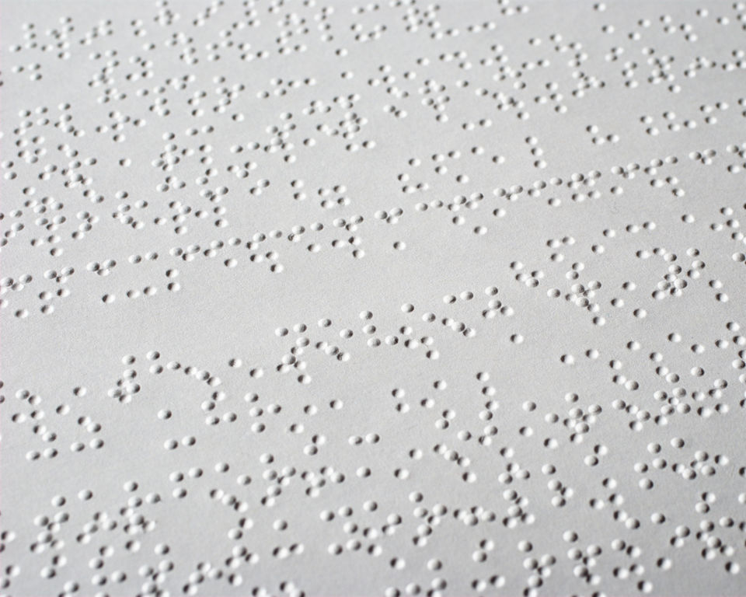
Braille

Slide 7
Braille
Still relevant after nearly 200 years
Only solution for direct access to text for blind persons
Plays a strong role in education of visually impaired kids

Slide 8
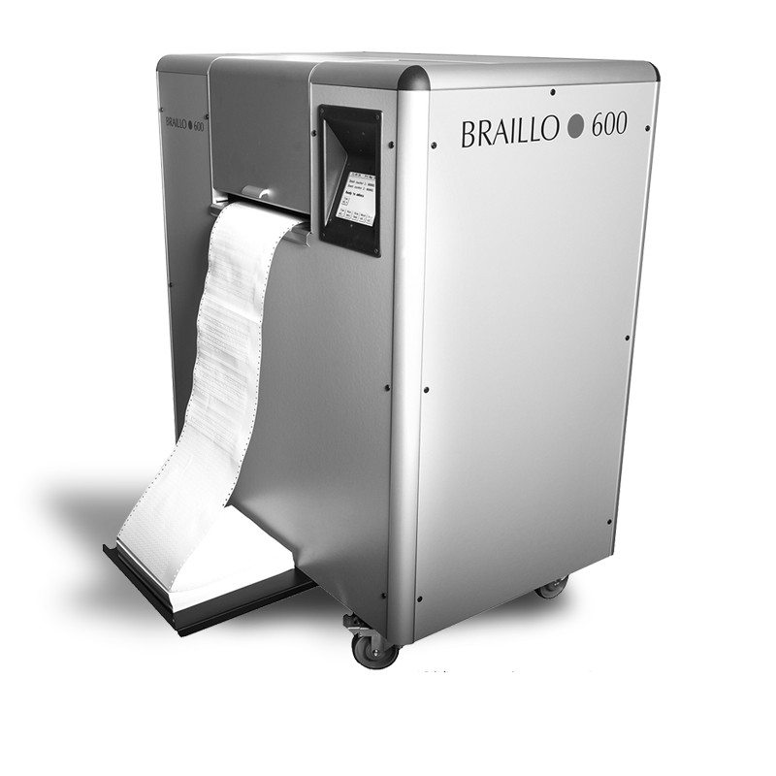
Printing braille on paper from files with a braille printer

Slide 9
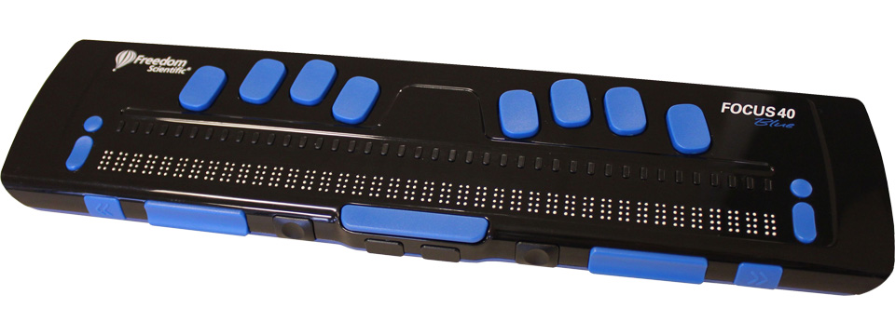
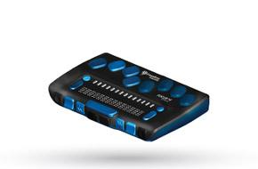
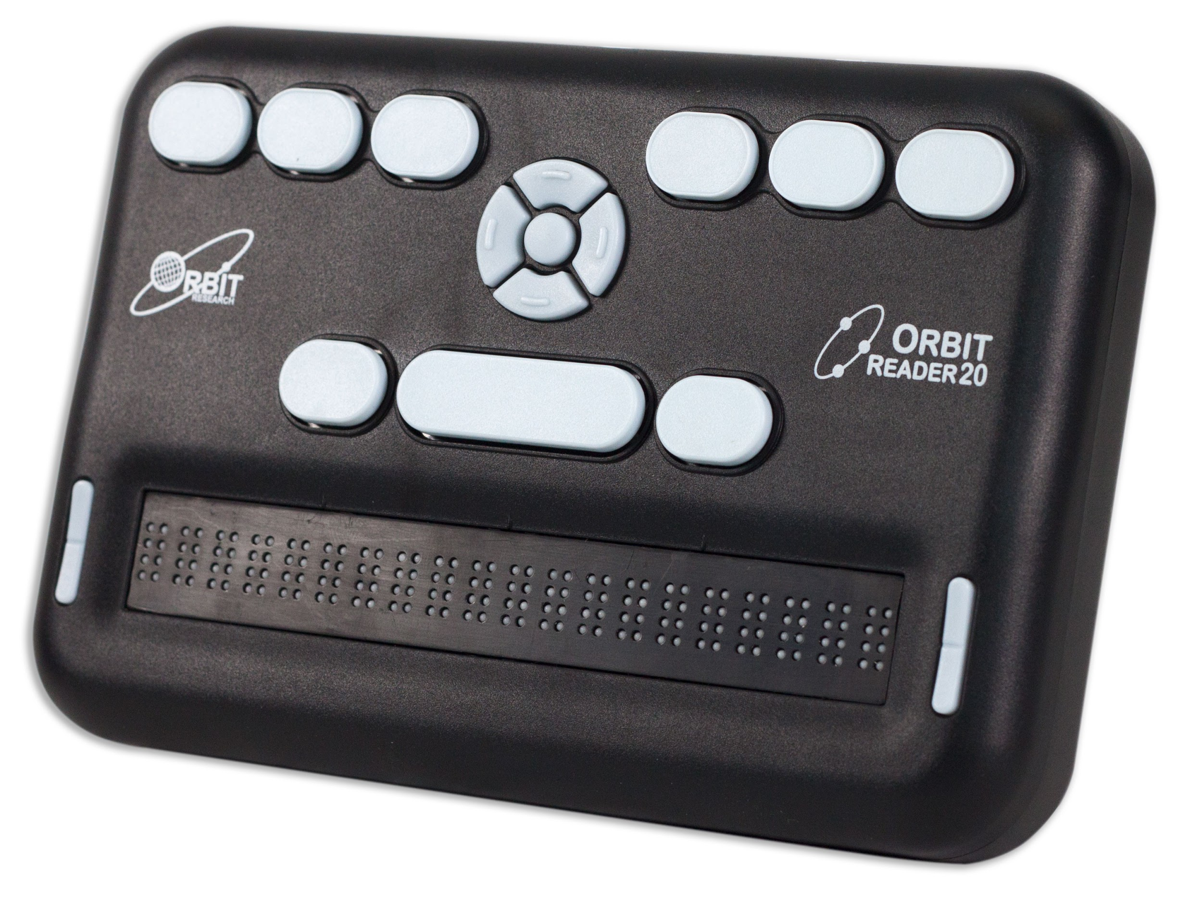
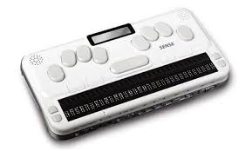
Refreshable braille displays

Slide 10
Reading with ears
The audiobooks
Human narration
Text to speech

Slide 11
Advantages of audiobooks
No need to learn a specific way of reading
Capacity to stock large number of books
Can address the needs of different categories of print impaired persons

Slide 12
Reading with eyes
large print
specific presentations for dyslexic users
specific interfaces for persons with physical disabilities

Slide 13
Specific presentations for dyslexic users
choice of typeface (Arial, Opendyslexic…)
Space between letters / words / lines
different colors for lines
Simplified text (short phrases…)

Slide 14
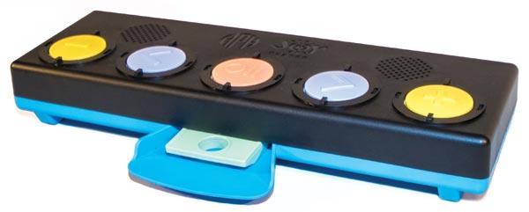
Interfaces for persons with physical disabilities : the joy player

Slide 15
Many ways of reading... files
Braille / audio / large print (...) are all produced from a digital file
Strong need for structured files
Strong need for a pivot format : EPUB3

Slide 16
Thank you for your attention
luc.maumet@wipo.int

